Slide 1
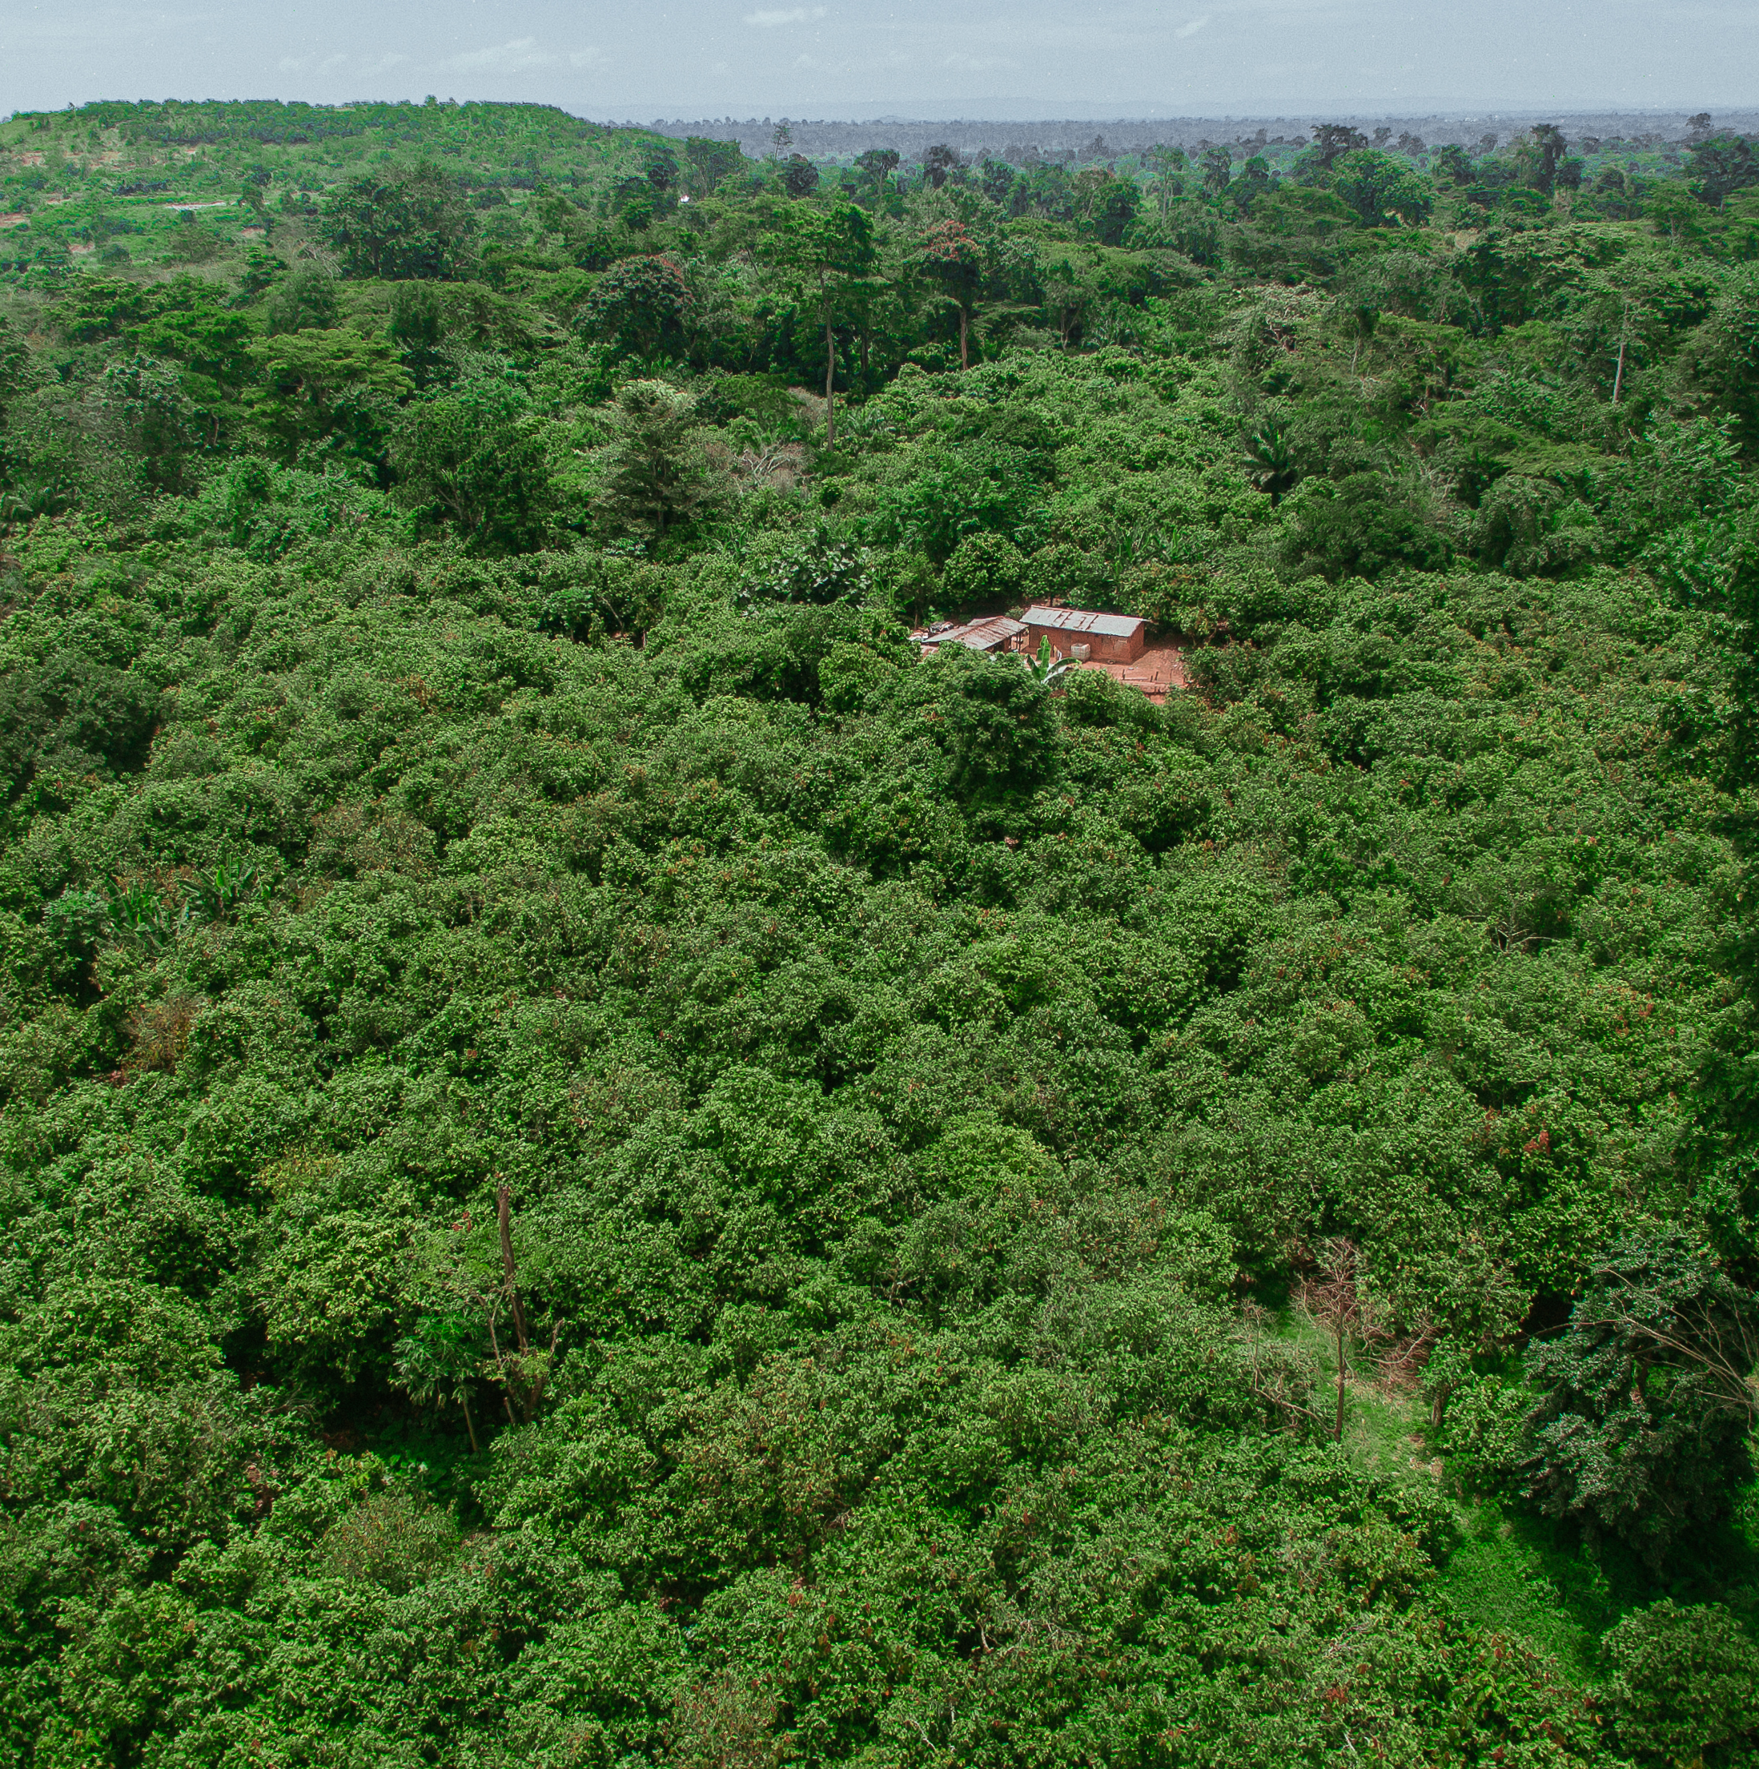
July 2025
The Landscape Blueprint: a primer for companies

Slide 2
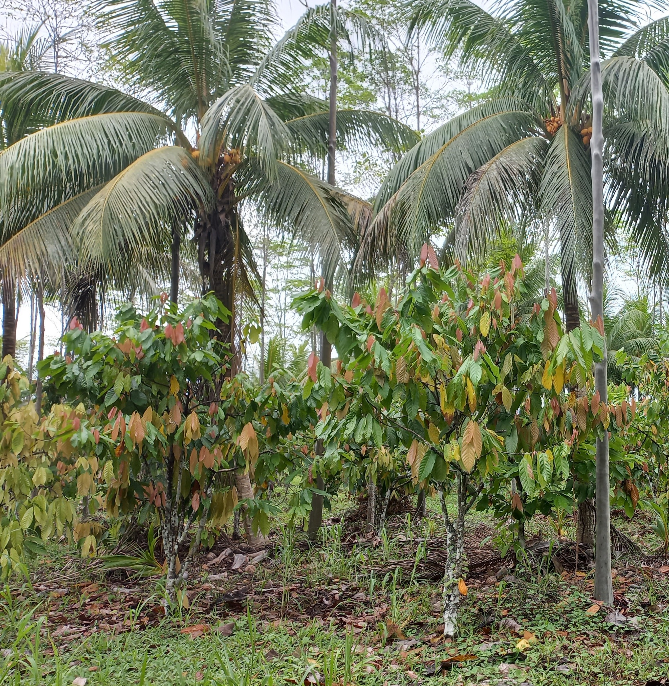
Why should companies work at landscape scale?
Companies cannot address root causes of issues alone in individual supply chains​
To tackle systemic issues such as deforestation, biodiversity loss or human rights abuses, many stakeholders are required. ​
Landscape and jurisdictional initiatives (LJIs) provide a way for companies to work with local and national governments, communities, and other stakeholders to mitigate supply chain risks that companies cannot address by themselves.​
LJIs are designed to bridge private sector and local stakeholder priorities to create longer, more sustained impact at scale.

Slide 3
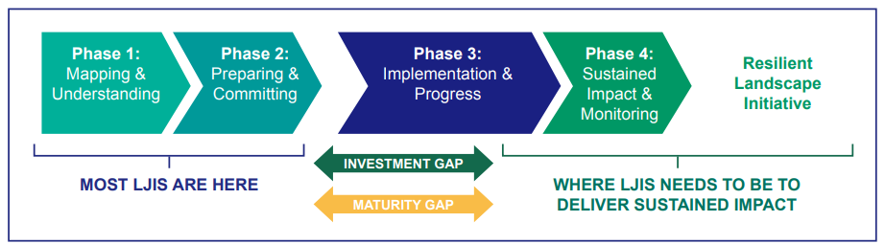
But engagement takes time…
The Landscape and Jurisdictional Initiative Maturity Process

Slide 4
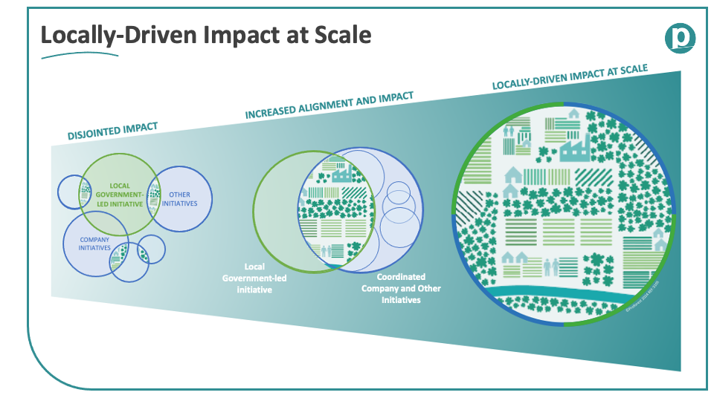
Why a Blueprint is needed
There are often many overlapping or not fully connected projects within a landscape, and when stakeholders in the landscape align them and create a shared vision then impact can be delivered at scale.

Slide 5
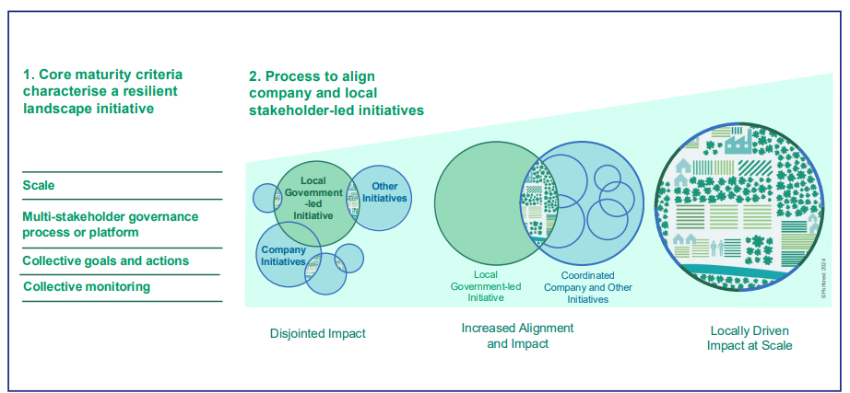
What is the Landscape Blueprint?
The Landscape Blueprint approach is made up of two elements:
1. A set of key components based on the Core Criteria for Mature Landscape Initiatives, which identify the characteristics of a mature, resilient landscape initiative. This was developed in 2024 by 20 landscape practitioners, including Proforest.
In addition, the Blueprint includes a focus on developing a long-term funding strategy.
2. A process to assess the current state of the LJI against the Core Maturity Criteria to understand the areas which may cause investment or maturity gaps.
This helps LJIs to structure a process for stakeholders to collectively review the assessment, identify opportunities for alignment and address the gaps identified.

Slide 6
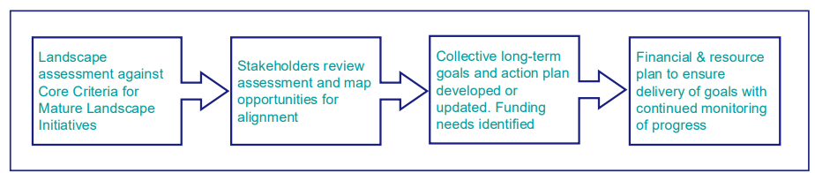
Piloting the Landscape Blueprint
We piloted the Blueprint in five landscapes in two countries through our work with the Consumer Goods Forum's Forest Positive Coalition. The objective was to test it in different scenarios – the flow of the pilots is described below:
It is important to emphasise that the Blueprint complements existing local action plans and incorporates them; it is not replacement/additional work

Slide 7
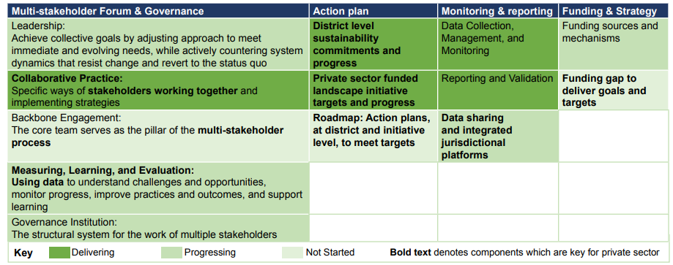
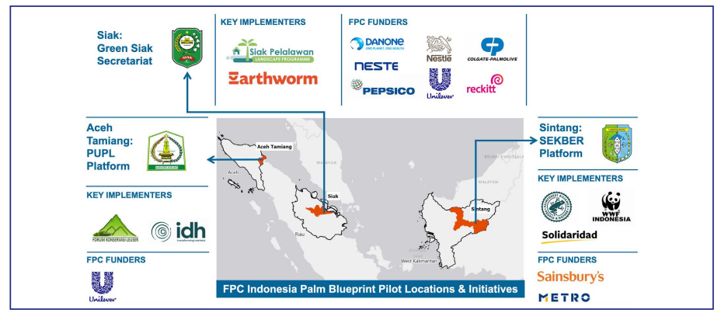
The 3 Blueprint pilots in Indonesia
Analysis of relative strengths and gaps of initiatives which participated in the pilot

Slide 8
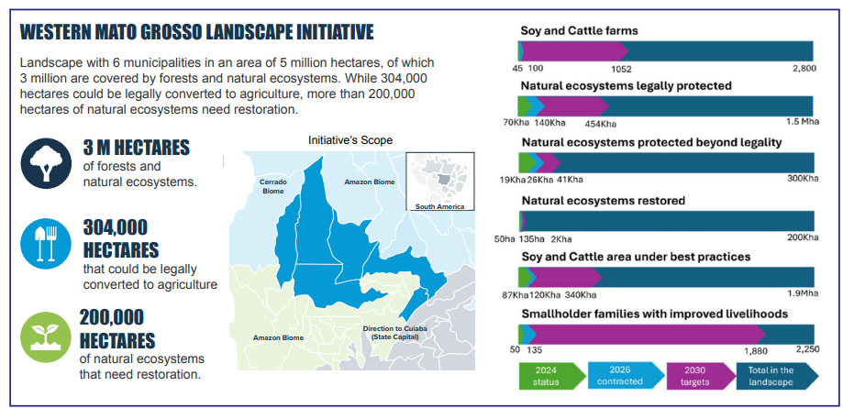
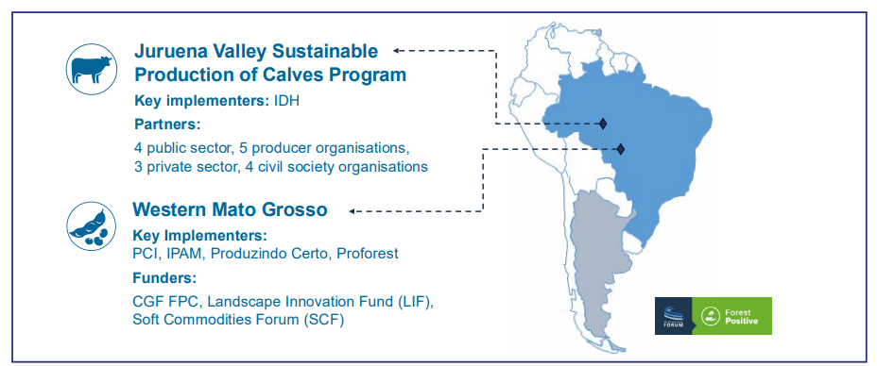
The 2 Blueprint pilots in Brazil
Example above of 2030 targets for the Western MT initiative and progress towards them

Slide 9



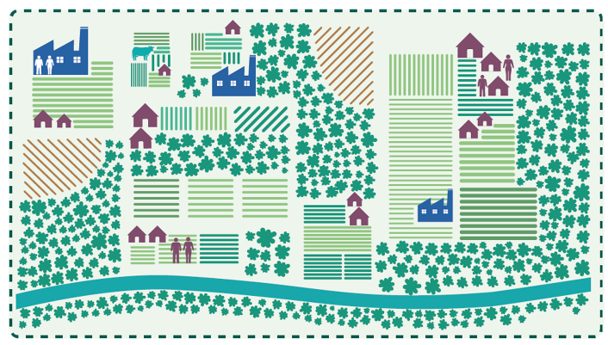
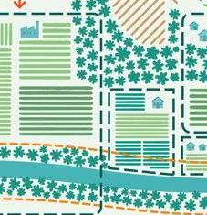
Funding needs and opportunities in LJIs
This visual illustrates the myriad funding needs and opportunities in a palm oil landscape.
Value Addition
HCV Areas Protection (company concessions)
Key Activities:
Landscape Multi-Stakeholder Partnership
Agri- Business Development
Social Forestry
Forest Conservation (government protected areas)
Agriculture & Production
Conservation & Restoration
IP & LCs Conserved Areas and Territories
New Business & Alternative Livelihoods
Enabling investments into the Landscape Multi-Stakeholder Partnership
Cooperative Training and Certification
Credit Provision
Eco-tourism
Visual credit Proforest

Slide 10
What can companies do next?
Multi-stakeholder Forum & Governance | Action plan | Monitoring & reporting | Funding & Strategy
Support for building capacity of multi-stakeholder forums, especially to build organizational capacity, coordination ability, and data systems. | Encourage landscape initiatives to develop long-term targets aligned with and/or supportive of district level goals | Align reporting expectations with locally defined KPIs and reporting platforms | Encourage landscape implementers to developed diversified funding strategy to deliver long term action plan and targets, including estimation of funding gap
 | Consider multi-year funding commitments to compliment need for long-term action planning by initiatives and other stakeholders | Encourage initiatives you support to report maturity progress using SourceUp

Slide 11
What can companies do next?
Find a landscape or jurisdictional initiative to invest in:
Making Commodity Sourcing More Sustainable With SourceUp | Home
Production landscapes - Proforest
2022-FPC-Landscapes-One-pager.pdf

Slide 12
rachel.wall@proforest.net

